Slide 1
Obstacle avoidance vehicle using 8051

Slide 2
TEAM MEMBERS
NAME | ROLL NO | KTU-ID
A NEERAJ | 08 | MDL22EC017
ROHITH RAVEENDRAN | 53 | MDL22EC105
ROHITH K | 52 | MDL22EC104

Slide 3
Table of contents
01
02
03
INTRODUCTION
LITERATURE REVIEW
DESIGN
04
05
06
RESULT
REFERENCE AND FUTURE SCOPE
DETAILS OF SOFTWARE TOOLS
A BRIEF INTRODUCTION ABOUT THE TOPIC
A BRIEF REVIEW ABOUT SIMILAR WORKS
DESIGN METHODOLOGY
EXPLANATION OF THE RESULT OBTAINED

Slide 4
INTRODUCTION
An obstacle avoidance vehicle based on the 8051 microcontroller is designed to navigate through environments autonomously by detecting and avoiding obstacles in its path. Using sensors such as ultrasonic or infrared, the vehicle can perceive its surroundings and make decisions based on the data received. By implementing suitable algorithms, the 8051 microcontroller enables the vehicle to maneuver effectively, making it an efficient and reliable solution for various applications

Slide 5
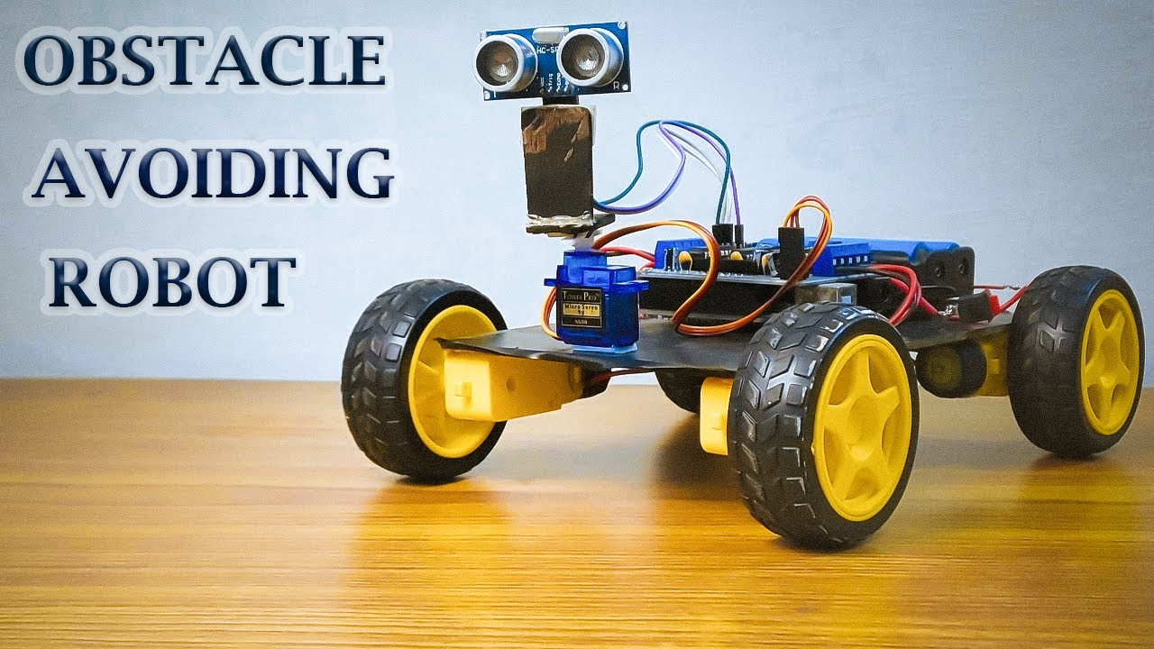
01
Previous studies have demonstrated the successful implementation of obstacle avoidance systems using the 8051 microcontroller. Wang et al. (2015) developed a vehicle navigation system employing infrared sensors and an 8051 microcontroller to achieve obstacle detection and avoidance. Similarly, Gupta and Kumar (2017) utilized infrared sensors with the 8051 microcontroller to create an efficient obstacle avoidance system for robotic vehicles, showcasing the versatility and effectiveness of this platform for autonomous navigation.
Literature review

Slide 6
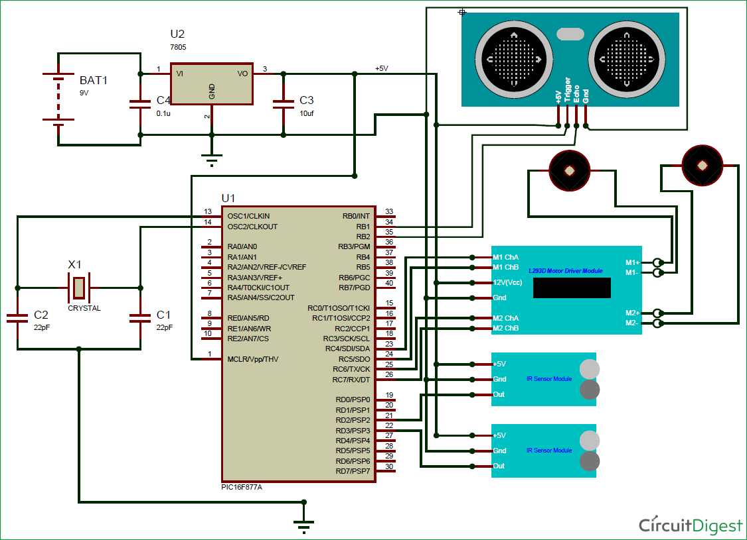
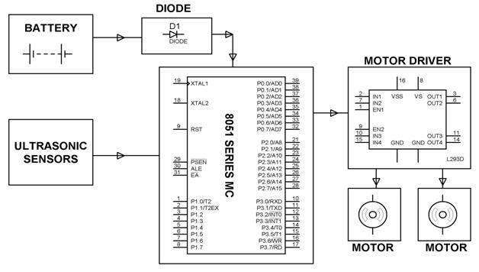
Awesome words
BLOCK DIAGRAM
INFRARED
SENSOR

Slide 7
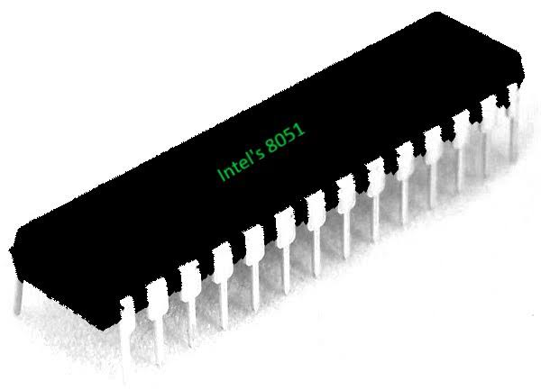
EXPLANATION OF EACH BLOCK IN 8051
8051 Microcontroller: The core of the system, the 8051 microcontroller, controls all the operations of the vehicle. It receives inputs from sensors, processes the data, and generates outputs to control the movement of the vehicle
INFRARED Sensors: These sensors are used to detect obstacles in the vehicle's path. They emit infrared rays and measure the time taken for the rays to bounce back. Based on this information, the microcontroller determines the distance to the obstacle
Motor Driver: The motor driver receives control signals from the microcontroller and regulates the speed and direction of the motors. It translates the digital signals from the microcontroller into appropriate voltage levels to drive the motors.

Slide 8
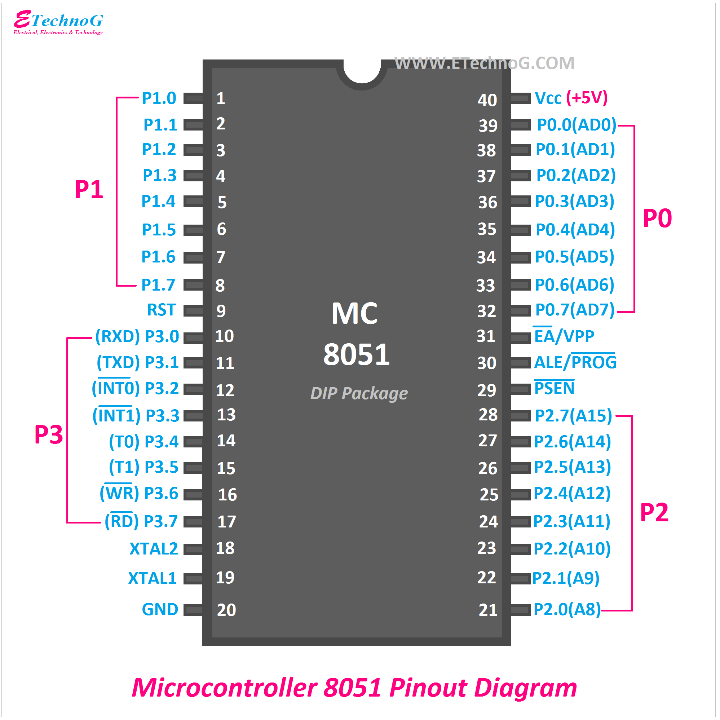
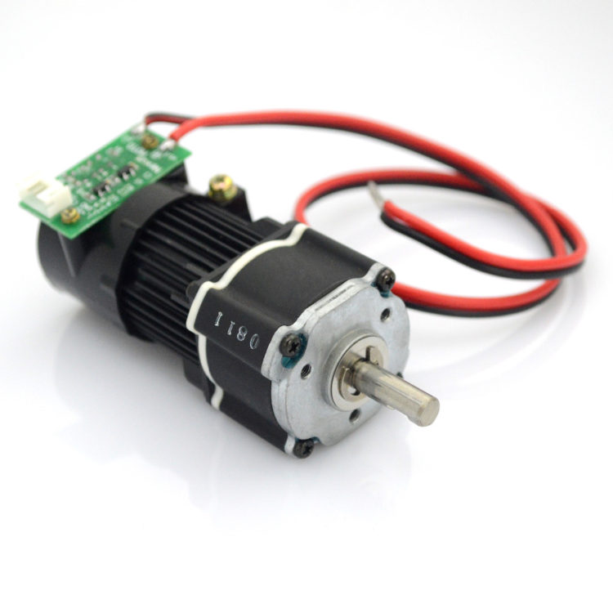
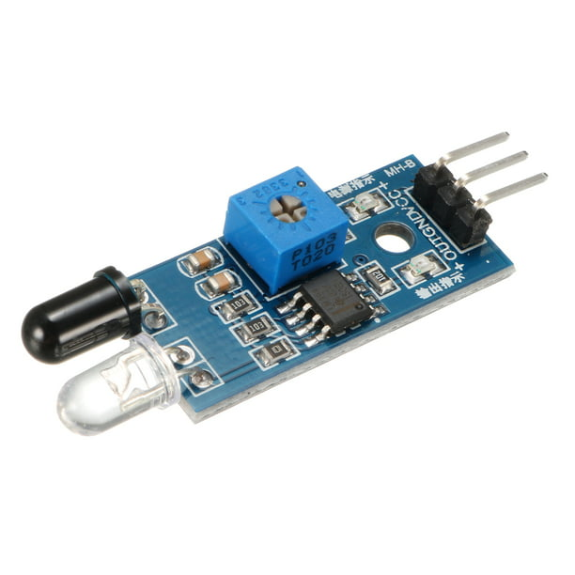
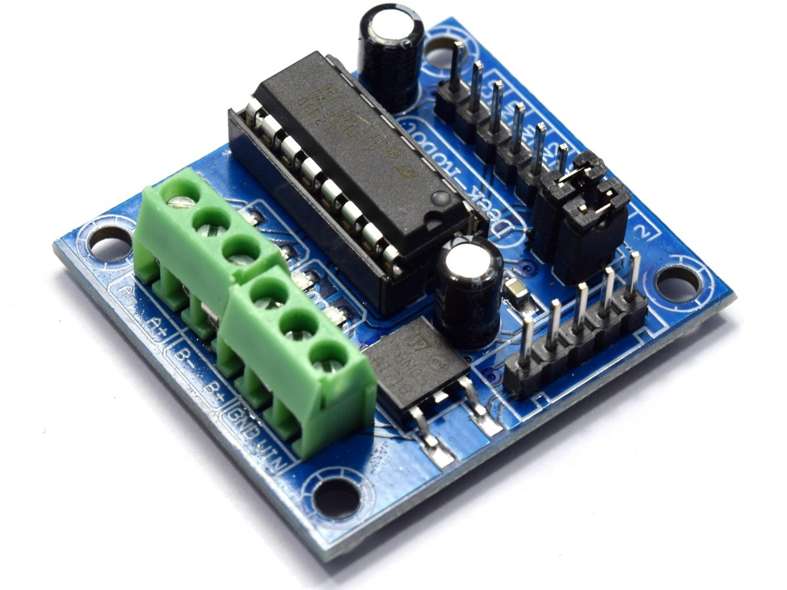
EXPLANATION OF EACH BLOCK IN 8051
DC Motors: These motors drive the wheels of the vehicle. The microcontroller controls the motors via the motor driver, allowing the vehicle to move forward, backward, or turn as required to avoid obstacles.

Slide 9
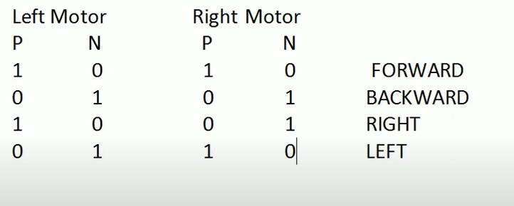
WORKING OF MOTOR
There are two inputs to a motor.A positive and negative.The direction of movement is controlled by this inputs.
When the motor connected to wheels move in opposite direction then the vehicle move in right or left dirction.

Slide 10


SOFTWARE USED
Proteus – It is a powerful software tool used for designing, simulating, and testing electronic circuits. It allows users to design PCB (Printed Circuit Board) layouts, simulate the behavior of microcontrollers, and test the functionality of their electronic circuits virtually before physically implementing them. With its intuitive interface and extensive component library, Proteus is widely used by engineers and students for electronic design and simulation purpose.
Keil- software is a development environment used for programming microcontrollers. It provides a comprehensive set of development tools, including compilers, debuggers, and integrated development environments (IDEs), making it easier for engineers to create embedded applications.Keil software is widely used in the electronics industry for developing embedded systems.

Slide 11
ALGORITHM
1. Start
2. Initialize the 8051 microcontroller and infrared sensors
3. Repeat the following steps indefinitely:
a. Read sensor values
b. If obstacle is detected:
i. Move backward
ii. Turn right
c. Else:
i. Move forward
4. End Repeat
5. Stop

Slide 12
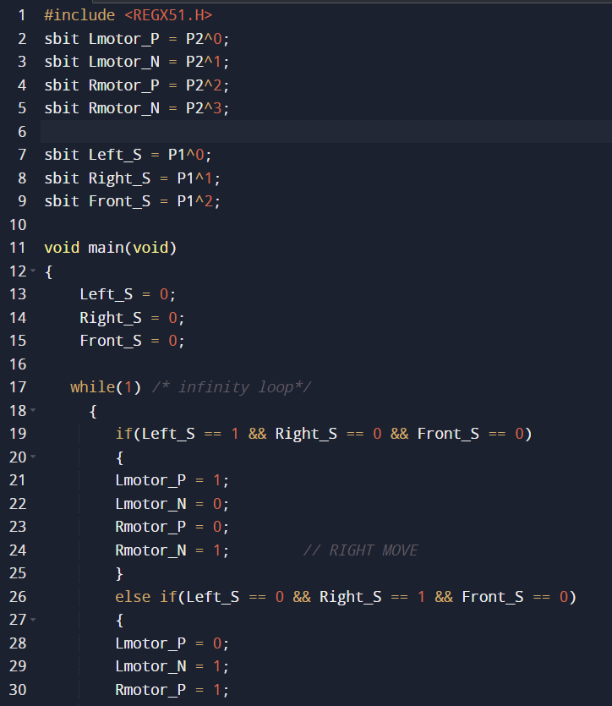
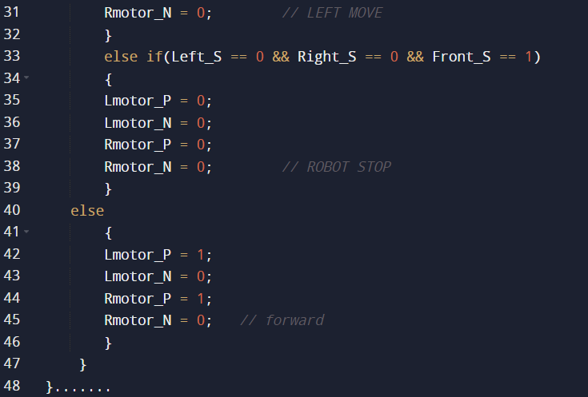
Embedded C program

Slide 13
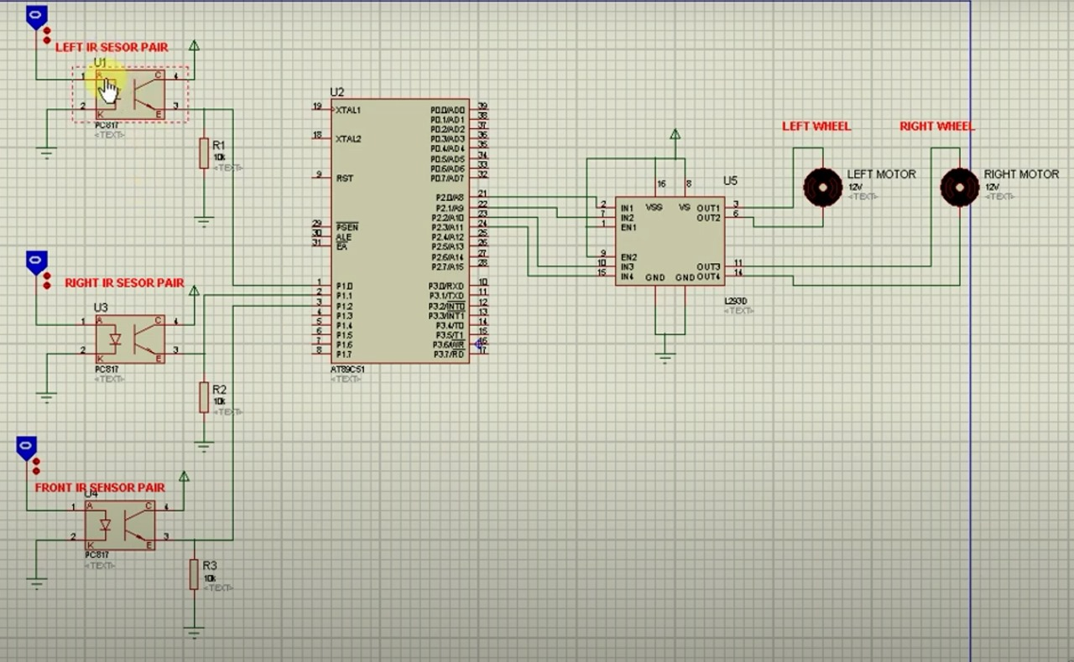
SIMULATION

Slide 14
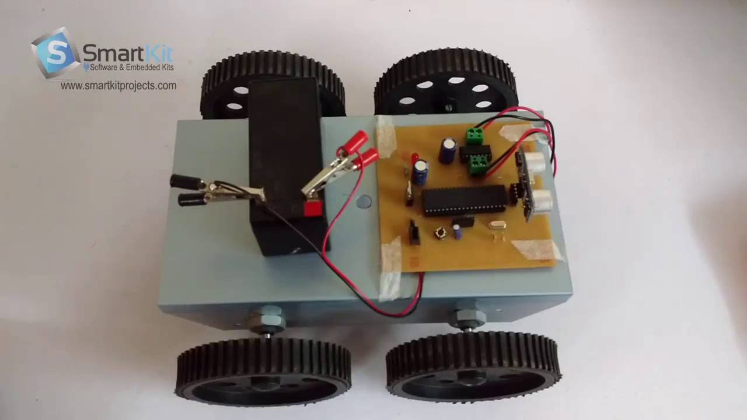
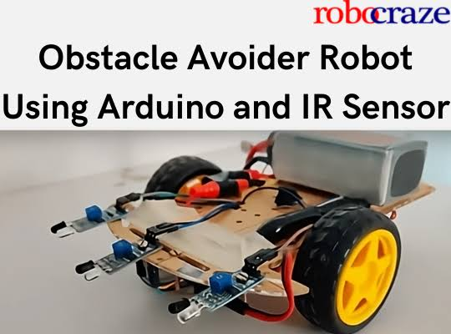
CONCLUSION
The obstacle avoidance vehicle based on the 8051 microcontroller demonstrates an effective and reliable solution for autonomous navigation. By integrating infrared sensors with the 8051 microcontroller, the vehicle successfully detects and avoids obstacles in its path. The vehicle's ability to maneuver autonomously makes it suitable for various applications, including surveillance, exploration, and transportation.

Slide 15
FUTURE SCOPE
Enhanced Navigation Algorithms:
Integration of Additional Sensors
Multi-vehicle Coordination
Implementing sophisticated algorithms for path and obstacle avoidance could improve efficiency
Integeration of cameras sensors,lidar etc,can improve navigation
To enable multiple vehicles to work together could expand the scope of applications

Slide 16

THANK YOU

